Slide 1

Vel Tech Rangarajan Dr. Sagunthala R&D Institute of Science and Technology
School of Computing
Department of Computer Science and Engineering
10211CS224 / FULL STACK APPLICATION DEVELOPMENT (JAVA)
END SEMESTER PROJECT REVIEW
Date: 06-05-2026
“TRAVEL TICKET BOOKING SYSTEM”
SDG:SDG 9 – Industry, Innovation and Infrastructure
Presented By:
O.VENKATA NAGA PRAVALIKA– VTU25784– 23UECS0408
Courses Handling Faculty:
Dr. M.SUMITHRA – Assistant professor

Slide 2
INTRODUCTION
Background of the Problem: Traditional ticket booking methods are time-consuming and require passengers to visit booking centers directly. Manual booking systems may also cause errors, delays, and inconvenience for users.
Why this Project is Important: This project provides an easy and secure way to book travel tickets through an online platform. It reduces manual work and improves the speed and accuracy of ticket management.
Real-World Relevance: Online ticket booking systems are widely used in buses, trains, and airline services today. The project supports digital transportation services and improves customer convenience in real-time booking.
Brief Overview of the System: The Travel Ticket Booking System allows users to register, search routes, book tickets, and manage cancellations online. It also includes features such as payment processing and travel information management.
1
2
3
4
5
6
7
8
9

Slide 3
PROBLEM STATEMENT
1
The existing travel ticket booking process in many places still depends on manual methods and separate booking platforms, which can cause delays and inconvenience for passengers. Users often face difficulties in checking ticket availability, comparing routes, and managing bookings efficiently. Manual handling of ticket reservations may also lead to errors, data redundancy, and poor record management. There is a need for a reliable and automated Travel Ticket Booking System that simplifies ticket reservation, improves accuracy, and provides quick access to travel information. The system should support easy booking, cancellation, and payment processes through a user-friendly interface. This project aims to enhance efficiency, reduce manual effort, and provide better service for both passengers and transport providers.
2
3
4
5
6
7
8
9

Slide 4
OBJECTIVE(S)
1
To develop an online Travel Ticket Booking System for easy and fast ticket reservation.
To provide users with features such as route search, ticket booking, cancellation, and payment processing.
To reduce manual work and improve the efficiency and accuracy of ticket management.
To maintain passenger and travel details securely in a centralized database system.
To create a user-friendly interface that improves customer convenience and accessibility.
2
3
4
5
6
7
8
9

Slide 5
PROPOSED SYSTEM
The proposed Travel Ticket Booking System provides an online platform for searching, booking, and cancelling travel tickets easily.
It automates ticket management processes, reducing manual work and minimizing human errors.
Users can check seat availability, travel schedules, and fare details in real time.
The system offers secure user authentication and safe payment processing for reliable transactions.
It stores passenger and booking information in a centralized database for easy management and quick access.
The solution improves booking speed and provides convenience by allowing users to access services anytime and anywhere.
Compared to traditional systems, it reduces paperwork, waiting time, and operational complexity.
The system enhances accuracy, efficiency, and customer satisfaction through a simple and user-friendly interface.
1
2
3
4
5
6
7
8
9

Slide 6
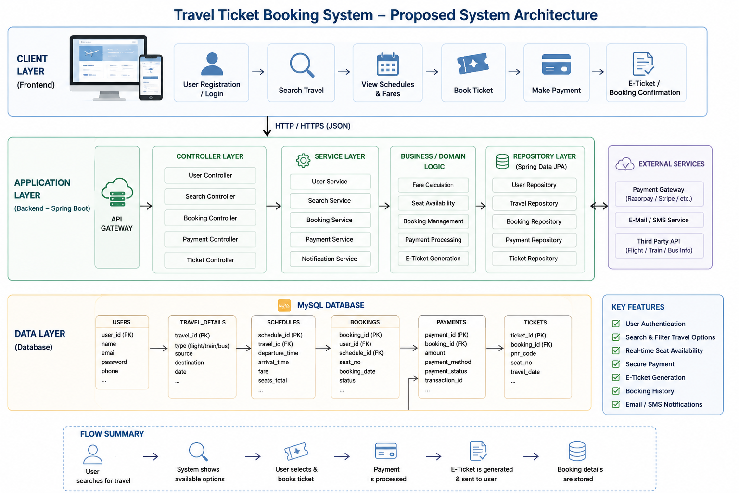
PROPOSED SYSTEM ARCHITECTURE
1
2
3
4
5
6
7
8
9

Slide 7
Input
User enters details like source, destination, date, and login credentials.
User provides booking inputs such as seat selection and payment information.
Processing
System validates user data, searches travel options, and checks seat availability.
System performs booking, processes payment, and generates e-ticket.
Database
Stores user, travel, booking, payment, and ticket details in structured tables.
Retrieves and updates data during search, booking, and payment operations.
Output
Displays available travel options and booking confirmation to the user.
Generates e-ticket and shows payment status/result.

Slide 8
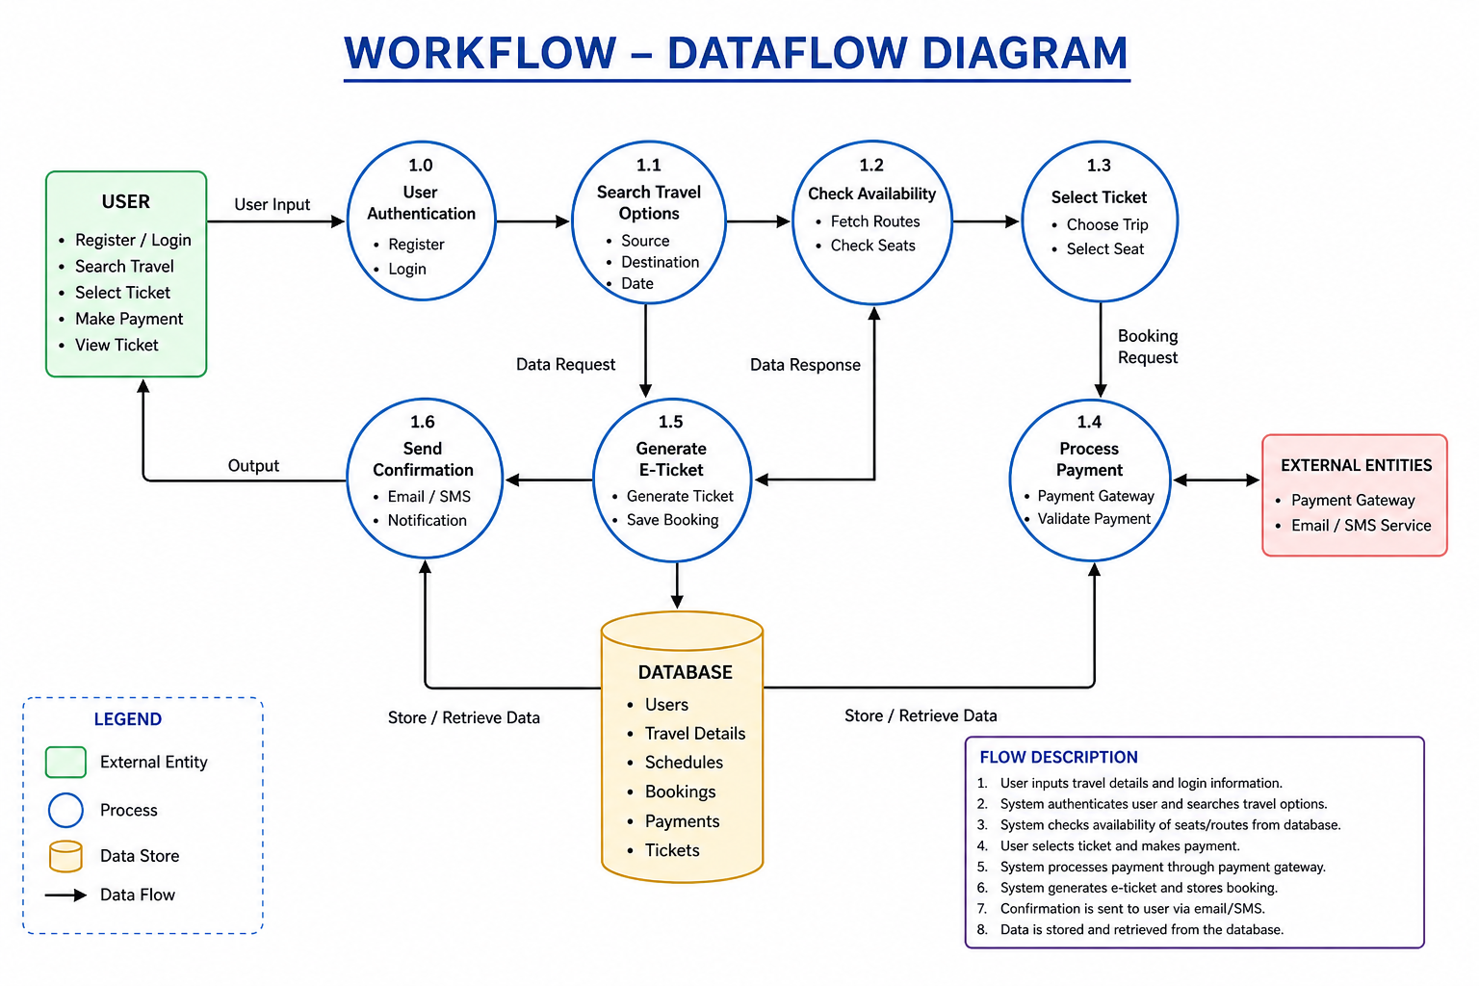
WORKFLOW
1
2
3
4
5
6
7
8
9

Slide 9
TECHNOLOGIES USED
1
Frontend:
Technologies used: HTML5, CSS3, React JS
Handles user interface for login, search, booking, and displaying tickets
Backend:
Developed using Spring Boot (REST APIs)
Handles business logic like authentication, booking, payment processing
Database:
MySQL database to store users, bookings, payments, and ticket details
Uses tables like Users, Travel, Schedules, Bookings, Payments, Tickets
2
3
4
5
6
7
8
9

Slide 10
MODULE DESCRIPTION
Module 1: User Management
Handles user registration, login, and profile management with secure authentication. Allows users to create accounts, log in, and manage their booking details.
Module 2: Ticket Search & Booking
Enables users to search buses/trains/flights based on source, destination, and date. Handles seat selection, fare calculation, and ticket booking process.
Module 3: Database Management
Manages storage of user data, travel details, bookings, payments, and tickets. Ensures secure data retrieval, updates, and consistency using MySQL.
Module 4: Integration & Smart Features
Integrates third-party APIs like payment gateway, email/SMS notifications. Includes smart features like auto fare calculation and real-time availability.
1
2
3
4
5
6
7
8
9

Slide 11
Third-Party API:
Payment Gateway API (Razorpay / Stripe) for handling transactions
External APIs for travel data (flight/train/bus info) and SMS/Email notifications
Tools:
Eclipse / VS Code for development
Git & GitHub for version control, Postman for API testing
Hardware/Software Requirements:
Hardware:
Minimum 4GB RAM, Intel i3 or above processor
Computer/Laptop with internet connection
Software:
Java (JDK 8+), Spring Boot, MySQL Server
Web browser (Chrome), Node.js (for React), Maven

Slide 12
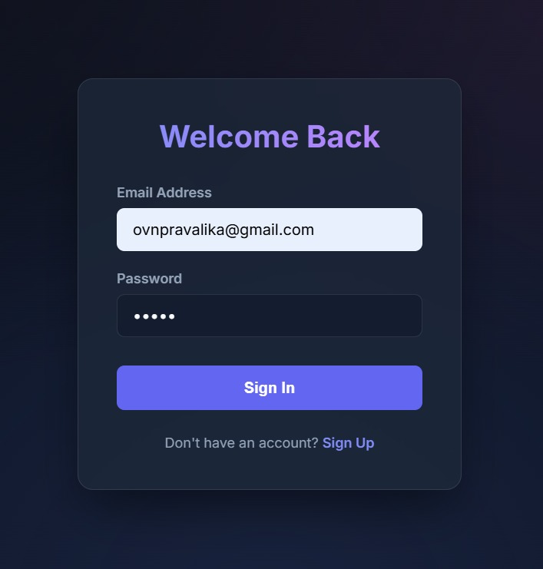
IMPLEMENTATION SCREENSHOTS
1
2
3
4
5
6
7
8
9
This screenshot shows a user login interface with fields for email address and password. It allows users to sign in to the system or navigate to the signup page if they don’t have an account.

Slide 13
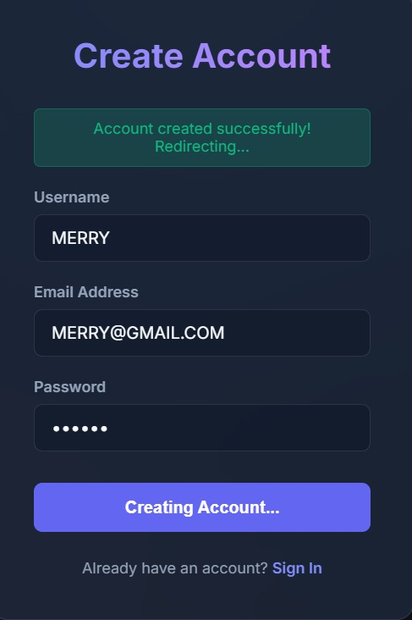
IMPLEMENTATION SCREENSHOTS
1
2
3
4
5
6
7
8(A)
9
This screenshot shows a user registration (Create Account) page with fields for username, email, and password.It displays a success message indicating the account has been created and the system is redirecting the user.

Slide 14
IMPLEMENTATION SCREENSHOTS
Admin Login Page
User Login Page
1
2
3
4
5
6
7
8(B)
9
User login page
Admin login page

Slide 15
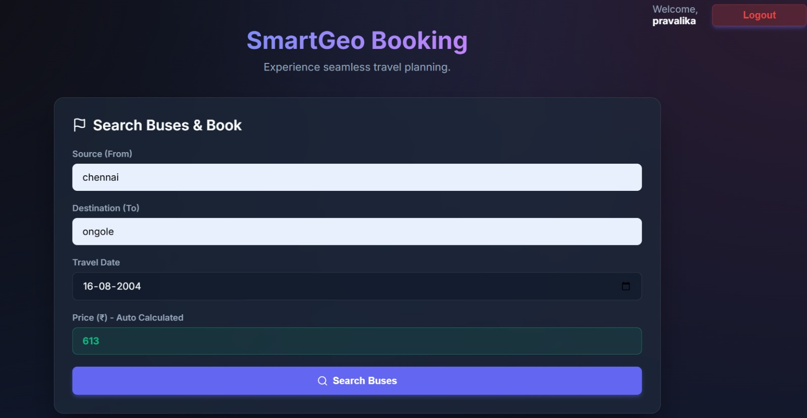
IMPLEMENTATION SCREENSHOTS
1
2
3
4
5
6
7
8(C)
9
This screenshot shows the Booking dashboard, where users can search and book buses by entering source, destination, and travel date.It also displays an automatically calculated price and provides a button to search available buses for booking.

Slide 16
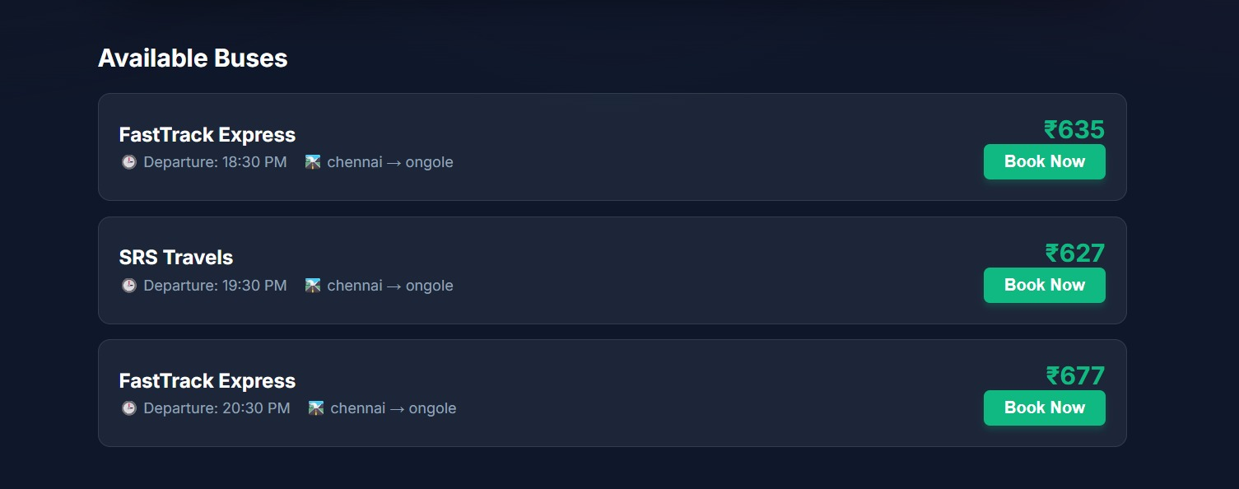
IMPLEMENTATION SCREENSHOTS
1
2
3
4
5
6
7
8(C)
9
Users can search for available buses by entering source, destination, and travel date.The system automatically calculates and displays the estimated ticket cost based on the selected route.

Slide 17
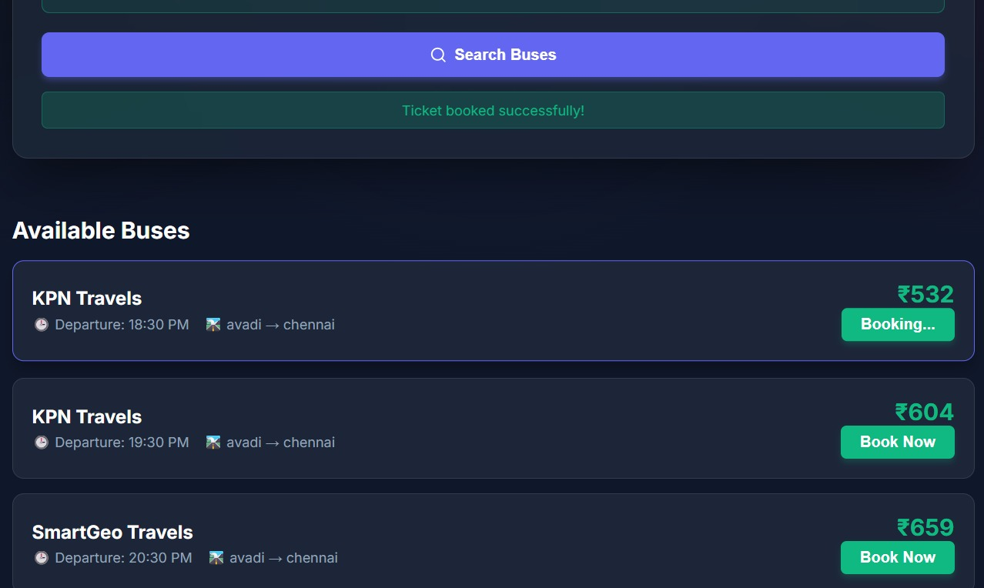
IMPLEMENTATION SCREENSHOTS
1
2
3
4
5
6
7
8(C)
9
After successful booking and payment, the system generates a digital e-ticket with journey and seat details.The ticket is displayed to the user and can be downloaded or sent via email/SMS for confirmation.

Slide 18
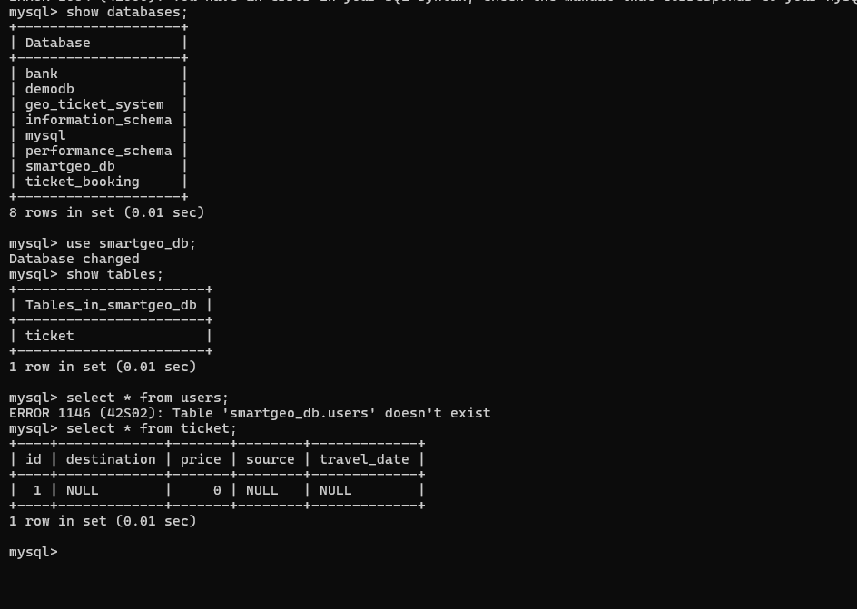
IMPLEMENTATION SCREENSHOTS
1
2
3
4
5
6
7
8(C)
9

Slide 19
ADVANTAGES & LIMITATIONS
1
Advantages
Convenience: Users can book tickets anytime and anywhere without visiting booking counters.
Time-Saving: Quick search, booking, and payment process reduces manual effort.
Real-Time Availability: Shows live seat availability and schedules.
Easy Payment: Supports online payment methods for faster transactions.
Digital Records: Stores booking history and e-tickets for future reference.
Limitations
Internet Dependency: Requires stable internet connection to access services.
Technical Issues: Server downtime or bugs may affect booking process.
Security Risks: Online transactions may face data/privacy threats if not secured.
Limited Access for Non-Tech Users: Some users may find it difficult to use the system.
Third-Party Dependency: Relies on external APIs (payment, travel data), which may fail.
2
3
4
5
6
7
8
9

Slide 20
Thank you

